Slide 1
Pipelined Processor Design

Slide 2
Outlines
Pipelining versus Serial Execution
Pipelined Data path
Pipeline Hazards
Data Hazards and Forwarding
Pipelined Control
Load Delay, Hazard Detection, and Stall Unit
Control Hazards
Delayed Branch and Dynamic Branch Prediction

Slide 3
Pipelining Example
Laundry Example: Three Stages
Wash dirty load of clothes
Dry wet clothes
Fold and put clothes into drawers
Each stage takes 30 minutes to complete
Four loads of clothes to wash, dry, and fold
A
B
C
D

Slide 4
Sequential Laundry
6 PM
7
8
9
10
11
12 AM
Time
30
30
30
30
30
30
30
30
30
30
30
30
A
B
C
D
Sequential laundry takes 6 hours for 4 loads
Intuitively, we can use pipelining to speed up laundry

Slide 5
Pipelined Laundry: Start Load ASAP
6 PM
7
8
9 PM
30
30
30
Time
30
30
30
30
30
30
30
30
30
A
Pipelined laundry takes 3 hours for 4 loads
Speedup factor is 2 for 4 loads
Time to wash, dry, and fold one load is still the same (90 minutes)
B
C
D

Slide 6
Serial Execution versus Pipelining
Consider a task that can be divided into k subtasks
The k subtasks are executed on k different stages
Each subtask requires one time unit
The total execution time of the task is k time units
Pipelining is to start a new task before finishing previous
The k stages work in parallel on k different tasks
Tasks enter/leave pipeline at the rate of one task per time unit.
1
2
…
k
1
2
…
k
1
2
…
k
1
2
…
k
1
2
…
k
1
2
…
k
Without Pipelining
One completion every k time units
With Pipelining
One completion every 1 time unit

Slide 7
Pipelining is one way of improving the overall processing performance of a processor.
This architectural approach allows the simultaneous execution of several instructions
The pipeline design technique decomposes a sequential process into several subprocesses, called stages or segments.
A stage performs a particular function and produces an intermediate result.
It consists of an input latch, also called a register or buffer, followed by a processing circuit.

Slide 8
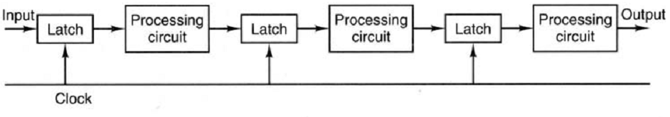
The processing circuit of a given stage is connected to the input latch of the next stage.
A clock signal is connected to each input latch.
At each clock pulse, every stage transfers its intermediate result to the input latch of the next stage.

Slide 9
The period of the clock pulse should be large enough to provide sufficient time for a signal to traverse through the slowest stage, which is called the bottleneck.
In addition, there should be enough time for a latch to store its input signals.

Slide 10
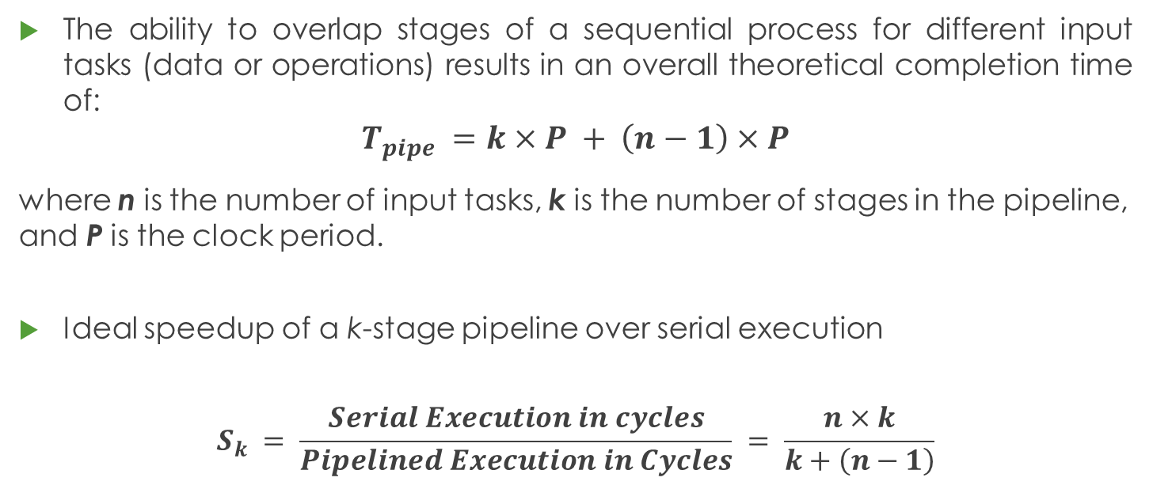
Pipeline Performance
The ability to overlap stages of a sequential process for different input tasks (data or operations) results in an overall theoretical completion time of:
$$T_{pipe} =k×P + \left(n−1\right)×P$$
where n is the number of input tasks, k is the number of stages in the pipeline, and P is the clock period.
Ideal speedup of a k-stage pipeline over serial execution
$$S_{k} = \frac{Serial Execution in cycles}{Pipelined Execution in Cycles} = \frac{n×k}{k+\left(n−1\right)}$$

Slide 11
To be more specific, when n is large, a pipelined processor can produce output approximately k times faster than a nonpipelined processor.

Slide 12
Next . . .
Pipelining versus Serial Execution
Pipelined Datapath
Pipeline Hazards
Pipelined Control
Data Hazards and Forwarding
Load Delay, Hazard Detection, and Stall Unit
Control Hazards
Delayed Branch and Dynamic Branch Prediction

Slide 13
INSTRUCTION PIPELINE
In a von Neumann architecture, the process of executing an instruction involves several steps.
Instruction fetch (IF). Retrieval of instructions from cache (or main memory).
Instruction decoding (ID). Identification of the operation to be performed.
Operand fetch (OF). Decoding and retrieval of any required operands.
Execution (EX). Performing the operation on the operands.
Write-back (WB). Updating the destination operands.

Slide 14
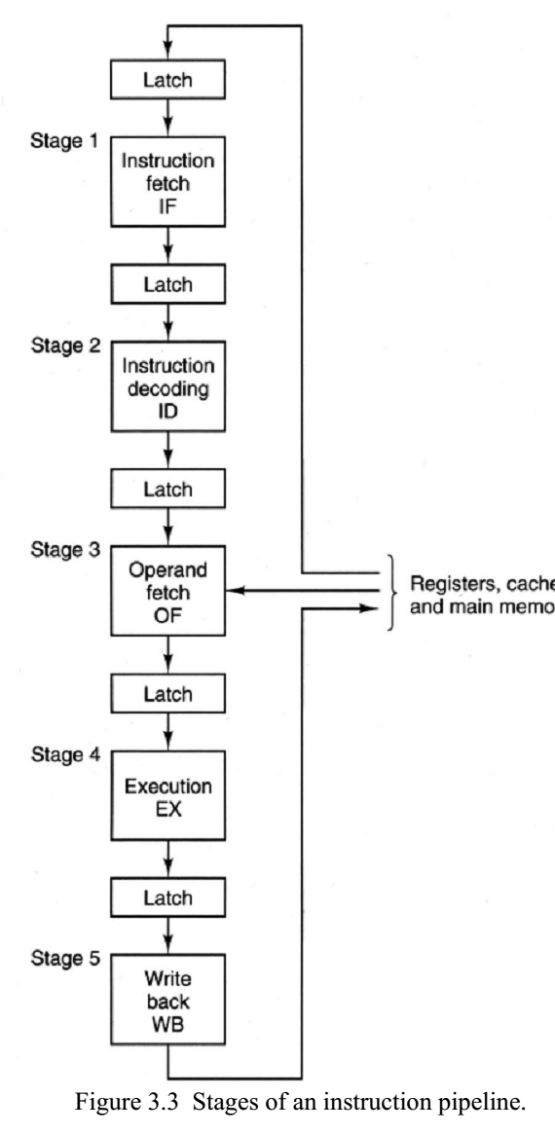
An instruction pipeline increases the performance of a processor by overlapping the processing of several different instructions.
Instruction pipeline overlaps the process of the preceding stages for different instructions to achieve a much lower total completion time, on average, for a series of instructions.

Slide 15
Single-Cycle Datapath
Shown below is the single-cycle datapath
How to pipeline this single-cycle datapath?
Answer: Introduce registers at the end of each stage
IF = Instruction Fetch
ID = Decode and Register Fetch
EX = Execute and Calculate Address
MEM = Memory Access
WB = Write Back
Inc
Next
PC
00
Imm26
ALU result
m
u
x
0
Rs
Imm16
zero
m
u
x
Instruction
Memory
Register
File
Data
Memory
0
PC
Address
Rt
A
L
U
1
Instruction
BusW
Ext
Address
1
RW
m
u
x
m
u
x
0
0
Data_in
Rd
1
1
Notes:
A datapath is a collection of functional units such as arithmetic logic units or multipliers, that perform data processing operations, registers, and buses. Along with the control unit it composes the central processing unit (CPU).

Slide 16
Pipelined Datapath
Pipeline registers, in green, separate each pipeline stage
Pipeline registers are labeled by the stages they separate
IF = Instruction Fetch
ID = Decode
EX = Execute
MEM = Memory
WB
IF/ID
ID/EX
EX/MEM
Inc
Next
PC
Imm26
MEM/WB
00
m
u
x
0
Imm16
zero
Instruction
Memory
Rs
Register
File
ALU result
m
u
x
PC
Address
0
Rt
Ext
A
L
U
Data
Memory
1
Instruction
Address
RW
m
u
x
1
BusW
m
u
x
Data_in
Rd

Slide 17
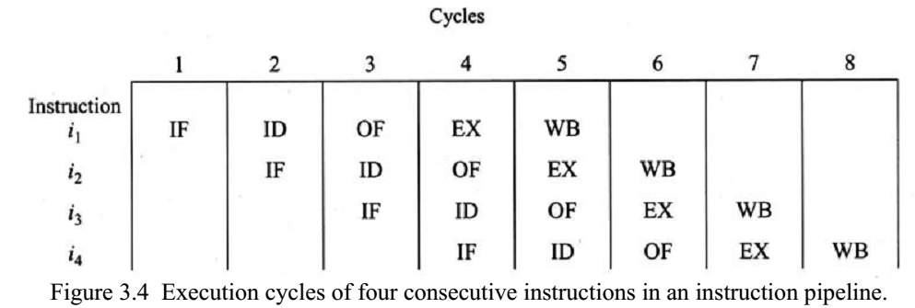
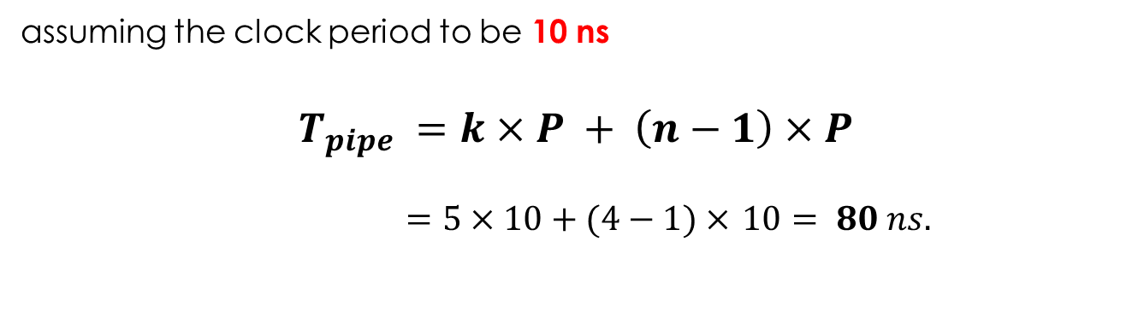
assuming the clock period to be 10 ns
$$T_{pipe} =k×P + \left(n−1\right)×P$$
$=5×10+(4−1)× 10= 80 ns.$

Slide 18

Note that in a nonpipelined design the completion time will be much higher:
$$Tseq = n×k×P$$
$$= 4×5×10 = 200 ns$$

Slide 19
Instruction–Time Diagram
Diagram shows:
Which instruction occupies what stage at each clock cycle
Instruction execution is pipelined over the 5 stages
Up to five instructions can be in execution during a single cycle
ALU instructions skip the MEM stage. Store instructions skip the WB stage
lw $7, 8($3)
IF
ID
EX
MEM
WB
lw $6, 8($5)
IF
ID
EX
MEM
WB
Instruction Order
or $4, $3, 7
IF
ID
EX
–
WB
sub $5, $2, $3
IF
ID
EX
–
WB
sw $2, 10($3)
IF
ID
EX
MEM
–
CC1
CC2
CC3
CC4
CC5
CC6
CC7
CC8
CC9
Time

Slide 20
Single-Cycle vs Pipelined Performance
Consider a 5-stage instruction execution in which …
Instruction fetch = ALU operation = Data memory access = 200 ps
Register read = register write = 150 ps
What is the single-cycle non-pipelined time?
What is the pipelined cycle time?
What is the speedup factor for pipelined execution?
Solution
Non-pipelined cycle =
200+150+200+200+150 = 900 ps
IF
Reg
ALU
MEM
Reg
900 ps
IF
Reg
ALU
MEM
Reg
900 ps

Slide 21
Single-Cycle versus Pipelined – cont’d
max(200, 150) = 200 ps
Pipelined cycle time =
CPI for pipelined execution =
One instruction completes each cycle (ignoring pipeline fill)
Speedup of pipelined execution =
Instruction count and CPI are equal in both cases
Speedup factor is less than 5 (number of pipeline stage)
Because the pipeline stages are not balanced
IF
Reg
ALU
MEM
Reg
200
IF
Reg
ALU
MEM
Reg
200
IF
Reg
ALU
MEM
Reg
200
200
200
200
200
1
900 ps / 200 ps = 4.5

Slide 22
The goal of pipelining is to allow multiple instructions execute at the same time.
We may need to perform several operations in a cycle
Increment the PC and add registers at the same time.
Fetch one instruction while another one reads or writes data.
The big benefit from pipelining comes from the fact that once you fed the first element into the pipe (an instruction, for example) the next cycle it's free to accept the next one, long before the previous elements finished the complete datapath.

Slide 23
Next . . .
Pipelining versus Serial Execution
Pipelined Datapath
Pipeline Hazards
Data Hazards and Forwarding
Load Delay, Hazard Detection, and Stall Unit
Pipelined Control
Control Hazards
Delayed Branch and Dynamic Branch Prediction

Slide 24
Pipeline Hazards
Hazards: situations that would cause incorrect execution
If next instruction were launched during its designated clock cycle
Structural hazards
When a resource is not available, Caused by resource contention
Using same resource by two instructions during the same cycle
Data hazards
An instruction may compute a result needed by next instruction
Hardware can detect dependencies between instructions
Control hazards
A control hazard refers to a situation in which an instruction, such as branch, causes a change in the program flow. (branches/jumps)
Delays in changing the flow of control.
Hazards are problems with the instruction pipeline in CPU microarchitectures when the next instruction cannot execute in the following clock cycle

Slide 25
Structural Hazards
Problem
Attempt to use the same hardware resource by two different
instructions during the same cycle
Example
Writing back ALU result in stage 4
Conflict with writing load data in stage 5
Structural Hazard
Two instructions are attempting to write the register file during same cycle
lw $6, 8($5)
IF
ID
EX
MEM
WB
or $4, $3, 7
IF
ID
EX
WB
Instructions
sub $5, $2, $3
IF
ID
EX
WB
sw $2, 10($3)
IF
ID
EX
MEM
CC1
CC2
CC3
CC4
CC5
CC6
CC7
CC8
CC9
Time

Slide 26
Resolving Structural Hazards
Serious Hazard:
Hazard cannot be ignored
Solution 1: Delay Access to Resource
Must have mechanism to delay instruction access to resource
Delay all write backs to the register file to stage 5
ALU instructions bypass stage 4 (memory) without doing anything
Solution 2: Add more hardware resources (more costly)
Add more hardware to eliminate the structural hazard
Redesign the register file to have two write ports
First write port can be used to write back ALU results in stage 4
Second write port can be used to write back load data in stage 5

Slide 27
Next . . .
Pipelining versus Serial Execution
Pipelined Datapath
Pipeline Hazards
Data Hazards and Forwarding
Load Delay, Hazard Detection, and Stall Unit
Control Hazards
Delayed Branch and Dynamic Branch Prediction
Pipelined Control

Slide 28

Data Hazards
In a pipelined processor, instruction executions are overlapped. An instruction may be started and completed before the previous instruction is completed.
The data hazard, or the data dependency problem, comes about as a result of overlapping (or changing the order of) the execution.

Slide 29
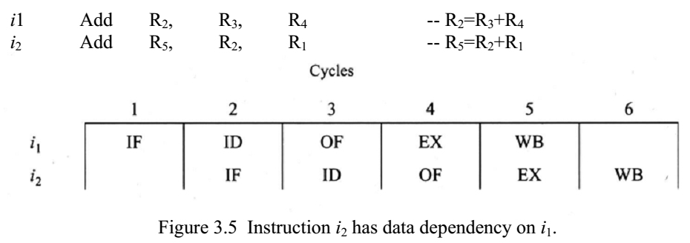
This would result in using the old contents of R2 for computing a new value for R5, leading to an invalid result.

Slide 30
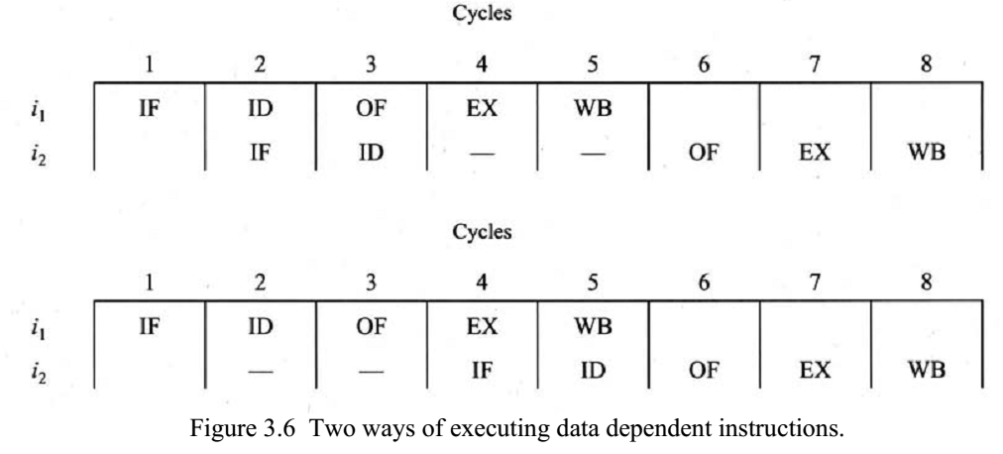
Solution1: Stalling
Instruction i2 is said to be stalled for two clock cycles. No Op(Bubbles are inserted)
Often, when an instruction is stalled, the instructions that are positioned after the stalled instruction will also be stalled. However, the instructions before the stalled instruction can continue execution.
To insert a delay, an extra hardware component called a pipeline interlock can be added to the pipeline. A pipeline interlock detects the dependency and delays the dependent instructions until the conflict is resolved

Slide 31
Another way is to let the compiler solve the dependency problem.
During compilation, the compiler detects the dependency between data and instructions. It then rearranges these instructions so that the dependency is not hazardous to the system.

Slide 32
Compiler Scheduling
Consider the following statements:
a = b + c; d = e – f;
Slow code:
lw $10, ($1) # $1 = addr b
lw $11, ($2) # $2 = addr c
add $12, $10, $11 # stall
sw $12, ($3) # $3 = addr a
lw $13, ($4) # $4 = addr e
lw $14, ($5) # $5 = addr f
sub $15, $13, $14 # stall
sw $15, ($6) # $6 = addr d
Fast code: No Stalls
lw $10, 0($1)
lw $11, 0($2)
lw $13, 0($4)
lw $14, 0($5)
add $12, $10, $11
sw $12, 0($3)
sub $15, $13, $14
sw $14, 0($6)

Slide 33

There are three primary types of data hazards: RAW (read after write), WAR (write after read), and WAW (write after write).
RAW: This type of data hazard was discussed previously; it refers to the situation in which i2 reads a data source before i1 writes to it.

Slide 34
WAR: This refers to the situation in which i2 writes to a location before i1 reads it.
an invalid result may be produced if i2 writes to R4 before i1 reads it; that is, the instruction i1 might use the wrong value of R4.
WAR cannot occur in our basic 5-stage pipeline because:
Reads are always in stage 2, and
Writes are always in stage 5
Instructions are processed in order

Slide 35
WAW: This refers to the situation in which i2 writes to a location before i1 writes to it.
the value of R2 is recomputed by i2.
WAW can’t happen in our basic 5-stage pipeline because:
All writes are ordered and always take place in stage 5
WAR and WAW hazards can occur in complex pipelines
Notice that Read After Read – RAR is NOT a hazard.

Slide 36
One way to enhance the architecture of an instruction pipeline is to increase concurrent execution of the instructions by dispatching several independent instructions to different functional units
That is, the instructions can be executed out of order, and so their execution may be completed out of order too.

Slide 37
Instruction 0: Register 1 = 6
Instruction 1: Register 1 = 3
Instruction 2: Register 2 = Register 1 + 7 = 10
Following execution, register 2 should contain the value 10. However, if Instruction 1 (write 3 to register 1) does not fully exit the pipeline before Instruction 2 starts executing, it means that Register 1 does not contain the value 3 when Instruction 2 performs its addition
In such an event, Instruction 2 adds 7 to the old value of register 1 (6), and so register 2 contains 13 instead, i.e.:
Instruction 0: Register 1 = 6
Instruction 2: Register 2 = Register 1 + 7 = 13
Instruction 1: Register 1 = 3
Forwarding helps correct such errors by depending on the fact that the output of Instruction 1 (which is 3) can be used by subsequent instructions it is stored in Register 1
https://en.wikipedia.org/wiki/Hazard_(computer_architecture)#Operand_forwarding

Slide 38
Forwarding
Forwarding applied to the example means that there is no wait to commit/store the output of Instruction 1 in Register 1 (in this example, the output is 3) before making that output available to the subsequent instruction (in this case, Instruction 2).
The effect is that Instruction 2 uses the correct (the more recent) value of Register 1: the commit/store was made immediately and not pipelined.
Forwarding is another solution to data hazard (dependency) with no bubbles/stalls.
https://en.wikipedia.org/wiki/Hazard_(computer_architecture)#Operand_forwarding

Slide 39
In today's architectures, the dependencies between instructions are checked statically by the compiler and/or dynamically by the hardware at run time.
This preserves the execution order for dependent instructions, which ensures valid results.

Slide 40
Next . . .
Pipelining versus Serial Execution
Pipelined Datapath
Pipeline Hazards
Data Hazards and Forwarding
Control Hazards
Delayed Branch and Dynamic Branch Prediction
Load Delay, Hazard Detection, and Stall Unit
Pipelined Control

Slide 41
Control Hazards
In any set of instructions, there is normally a need for some kind of branches.
In general, about 30% of all instructions in a program are branches.
Thus branch instructions in the pipeline can reduce the throughput tremendously if not handled properly.
Each such branch requires a new address to be loaded into the program counter, which may invalidate all the instructions that are either already in the pipeline or prefetched in the buffer.
This draining and refilling of the pipeline for each branch degrades the throughput of the pipeline to that of a sequential processor
A branch not taken allows the continued sequential flow of uninterrupted instructions to the pipeline.

Slide 42
Branch instruction may be one of:
(1)unconditional branch, (2) conditional branch, and (3) loop branch.
An unconditional branch always alters the sequential program flow.
A conditional branch sets a new target address in the program counter only when a certain condition is satisfied.
When the condition is satisfied, the path starts from the target address and is called a target path. If it is not, the path starts from the next sequential instruction and is called a sequential path.
A loop branch in a loop statement usually jumps back to the beginning of the loop and executes it either a fixed or a variable (data-dependent) number of times.
Among all of above, conditional branches are the hardest to handle

Slide 43
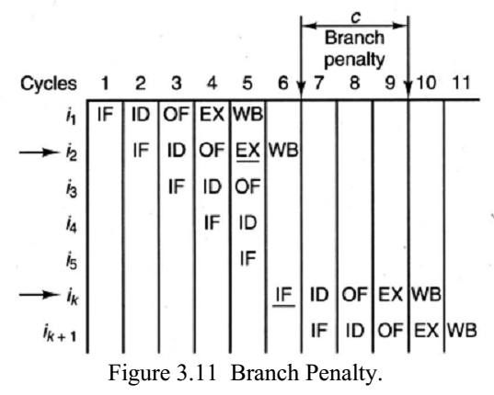
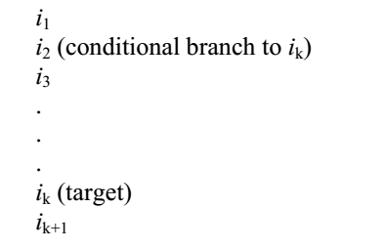
e.g.

Slide 44
To reduce the effect of branching some of the better known techniques are branch prediction, delayed branching, and multiple prefetching.

Slide 45
Branch Prediction
In this type of design, the outcome of a branch decision is predicted before the branch is actually executed.
Based on a particular prediction, the sequential path or the target path is chosen for execution.
Chosen path may often reduces the branch penalty, it may increase the penalty in case of incorrect prediction.

Slide 46
Static vs Dynamic Prediction
In static prediction, a fixed decision for prefetching one of the two paths is made before the program runs.
For example, a simple technique would be to always assume that the branch is taken.
This technique simply loads the program counter with the target address when a branch is encountered
Another such technique is to automatically choose one path (sequential or target) for some branch types and another for the rest of the branch types.
If the chosen path is wrong, the pipeline is drained and instructions corresponding to the correct path are fetched; the penalty is paid

Slide 47
Static vs Dynamic Prediction
In dynamic prediction, during the execution of the program the processor makes a decision based on the past information of the previously executed branches.
For example, recording the history of the last two paths taken by each branch instruction. If the last two executions of a branch instruction have chosen the same path, that path will be chosen for the current execution of the branch instruction. If the two paths do not match, one of the paths will be chosen randomly.

Slide 48
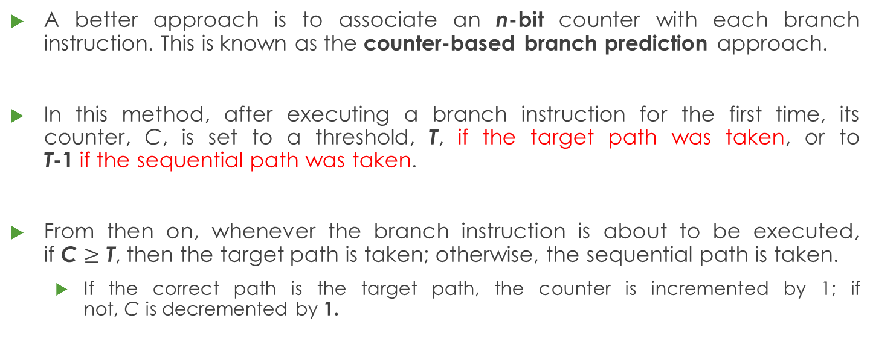
Counter Based Branch Prediction
A better approach is to associate an n-bit counter with each branch instruction. This is known as the counter-based branch prediction approach.
In this method, after executing a branch instruction for the first time, its counter, C, is set to a threshold, T, if the target path was taken, or to T-1 if the sequential path was taken.
From then on, whenever the branch instruction is about to be executed, if C $≥$ T, then the target path is taken; otherwise, the sequential path is taken.
If the correct path is the target path, the counter is incremented by 1; if not, C is decremented by 1.

Slide 49
Delayed Branching
In this type of design, a certain number of instructions after the branch instruction is fetched and executed regardless of which path will be chosen for the branch.
For example, a processor with a branch delay of k executes a path containing the next k sequential instructions and then either continues on the same path or starts a new path from a new target address.
The compiler tries to fill the next k instruction slots after the branch with instructions that are independent from the branch instruction. NOP (no operation) instructions/bubbles are placed in any remaining empty slots
Notes:
- K may be taken as clock cycles

Slide 50
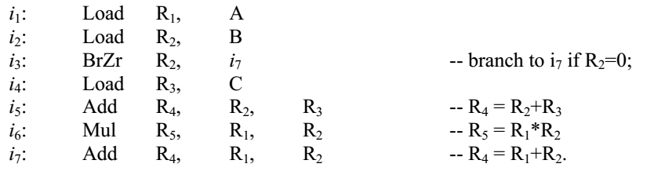

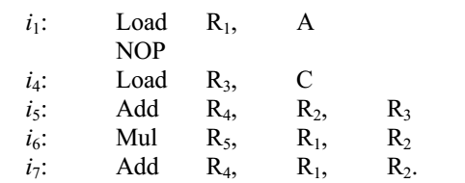
e.g. k=2

Slide 51
Multiple Prefetching
In this type of design, the processor fetches both possible paths.
Once the branch decision is made, the unwanted path is thrown away.
By prefetching both possible paths, the fetch penalty is avoided in the case of an incorrect prediction.
To fetch both paths, two buffers are employed to service the pipeline.

Slide 52
In normal execution, the first buffer is loaded with instructions from the next sequential address of the branch instruction.
If a branch occurs, the contents of the first buffer are invalidated, and the secondary buffer, which has been loaded with instructions from the target address of the branch instruction, is used as the primary buffer.
This double buffering scheme ensures a constant flow of instructions and data to the pipeline and reduces the time delays caused by the draining and refilling of the pipeline

Slide 53
Next . . .
Pipelining versus Serial Execution
Pipelined Datapath
Pipeline Hazards
Data Hazards and Forwarding
Control Hazards
Delayed Branch and Dynamic Branch Prediction
Load Delay, Hazard Detection, and Stall Unit

Slide 54
Load Delay
Unfortunately, not all data hazards can be forwarded
Load has a delay that cannot be eliminated by forwarding
In the example shown below …
The LW instruction does not have data until end of CC4
AND instruction wants data at beginning of CC4 - NOT possible
Time (cycles)
CC1
CC2
CC3
CC4
CC5
CC6
CC7
CC8
lw $2, 20($1)
IF
Reg
DM
Reg
However, load can forward data to second next instruction
ALU
Program Order
and $4, $2, $5
IF
Reg
ALU
DM
Reg
or $6, $3, $2
IF
Reg
ALU
DM
Reg
add $7, $2, $2
IF
Reg
ALU
DM
Reg

Slide 55
Stall the Pipeline for one Cycle
Freeze the PC and the IF/ID registers
No new instruction is fetched and instruction after load is stalled
Allow the Load instruction in ID/EX register to proceed
Introduce a bubble into the ID/EX register
Load can forward data to next instruction after delaying it
Time (cycles)
CC1
CC2
CC3
CC4
CC5
CC6
CC7
CC8
lw $2, 20($1)
IM
Reg
ALU
DM
Reg
Program Order
and $4, $2, $5
IM
bubble
Reg
ALU
DM
Reg
or $6, $3, $2
IM
Reg
ALU
DM
Reg

Slide 56
Pipeline Control
Controlling the sequence of tasks presented to a pipeline for execution is extremely important for maximizing its utilization.
If two tasks are initiated requiring the same stage of the pipeline at the same time, a collision occurs, which temporarily disrupts execution.

Slide 57
Pipeline Control: Scheduling
Reservation Table: A pipeline reservation table shows when stages of a pipeline are in use for a particular function.
Each stage of the pipeline is represented by a row in the reservation table.
Each row of the reservation table is in turn broken into columns, one per clock cycle.

Slide 58
Pipelining Summary
Pipelining doesn’t improve latency of a single instruction
However, it improves throughput of entire workload
Instructions are initiated and completed at a higher rate
In a k-stage pipeline, k instructions operate in parallel
Overlapped execution using multiple hardware resources
Potential speedup = number of pipeline stages k.
Unbalanced lengths of pipeline stages reduces speedup
Pipeline rate is limited by slowest (bottleneck) pipeline stage.
Unbalanced lengths of pipeline stages reduces speedup
Also, time to fill and drain pipeline reduces speedup

Slide 59
Pipelining Summary
Three types of pipeline hazards
Structural hazards: conflicts using a resource during same cycle
Data hazards: due to data dependencies between instructions
Control hazards: due to branch and jump instructions
Hazards limit the performance and complicate the design
Structural hazards: eliminated by careful design or more hardware
Data hazards are eliminated by forwarding
However, load delay cannot be eliminated and stalls the pipeline
Delayed branching can be a solution when branch delay = 1 cycle
Branch prediction can reduce branch delay to zero
Branch misprediction should drain the wrongly fetched instructions

